Slide 1
Difference in Difference

Slide 2
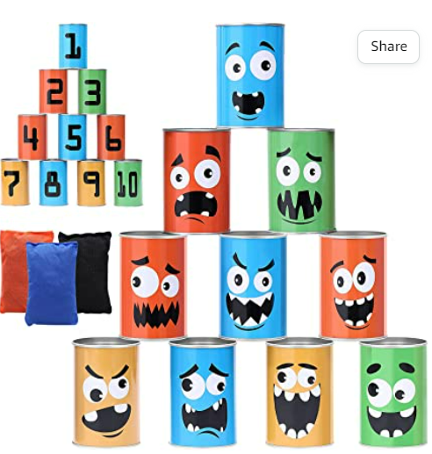
Bean Bag Toss: A game to explore a difference in difference research design
How many can you knock down?
Notes:
Explain to students that they will be playing a tabletop bean bag toss game,where there is a stack of tin cans and the students must stand behind a line and toss a bean bag into the cans to try to knock down as many as they can. Let them know that we will be using this activity to investigate a statistical concept, but that we will discuss the specifics later.

Slide 3
Rules of the game:
The class will be divided into two teams
Each team should:
Come up with a team name and record it on your index card
Team members take turns based on the number on index card
Throw bean bag to see how many cans each member can knock down
Record that number on their index card
When instructed, plot data on graph.
Link to the Data table and graph for activity
The team that knocks down the most cans wins!

Slide 4
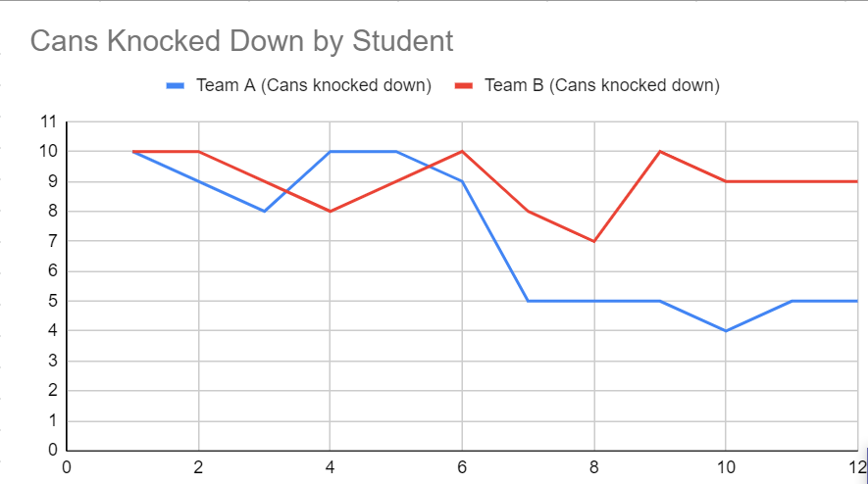
Sample Graph
# of Cans Knocked Down
Student
Notes:
Questions to lead discussion:
Why do we use line graphs?
What information do they help us visualize?
Hopefully students know that they help us see trends in our data. Then ask “What trends do we notice about this data? Who won? Was one team winning the entire time? What happened here? (pointing to the dip in Team A’s performance in round 2) Why do you think that happened?”
Instructors can then let students in on the fact that the cans were swapped out for weighted cans. The dip in our data shows the point where something in the environment changed

Slide 5
What is Difference-in-Difference?
Difference-in-difference is a statistical technique used in research
It mimics an experimental research design in a natural setting by asking if a group that was affected by a treatment had a different outcome than the group that was not (control)
It compares an outcome (like bean bags or deaths) before a treatment to an outcome afterwards (difference 1 for group 1) and then compares the trend in deaths to the control group (difference 2)
Because we’re comparing these two differences, this is a “difference-in-difference” design
If we see a significant difference in trends for the two groups (difference in difference) that is a clue that the treatment had an impact
Notes:
After explaining the concept have students either look at the graph that they created or the sample graph provided and identify the following:
Treatment group - group A
Control group - group B
Bean bag count before and after the intervention

